Slide 1
Product Owner Portfolio
Data-Driven Product Strategy | Agile Execution | KPI Governance

Slide 2
Core Product Owner Capabilities
• Backlog Prioritization (RICE / MoSCoW)
• User Stories & Acceptance Criteria
• Sprint Planning & Agile Delivery
• Roadmap & Release Strategy
• KPI Governance & Funnel Optimization
• Stakeholder Alignment & Executive Communication
Jamie Christian | Product Owner Portfolio

Slide 3
Impact Highlights
18%
Reduction in Checkout Abandonment
25%
Improvement in Reporting Accuracy
40%
Increase in NPS Visibility
22%
Page Speed Improvement
Jamie Christian | Product Owner Portfolio

Slide 4
Technical Stack
Agile: Jira (Epics, Sprints, Roadmaps, Backlogs)
Analytics: Power BI, Tableau, Advanced Excel
Data: SQL (Joins, Aggregations, Funnel Queries), Python
Documentation: PRDs, Roadmaps, Stakeholder Matrices
Jamie Christian | Product Owner Portfolio

Slide 5
Value Proposition
Data-driven Product Owner focused on measurable product impact.
I translate strategy into structured execution,
align cross-functional stakeholders,
and deliver sprint outcomes validated by performance metrics.
Jamie Christian | Product Owner Portfolio

Slide 6
Product Roadmap Timeline
Q1
Q2
Q3
Q4
KPI Baseline & Dashboard Launch
Checkout Optimization & A/B Testing
Performance Improvements & UX Enhancements
Governance, Automation & Scale
Jamie Christian | Product Owner Portfolio

Slide 7
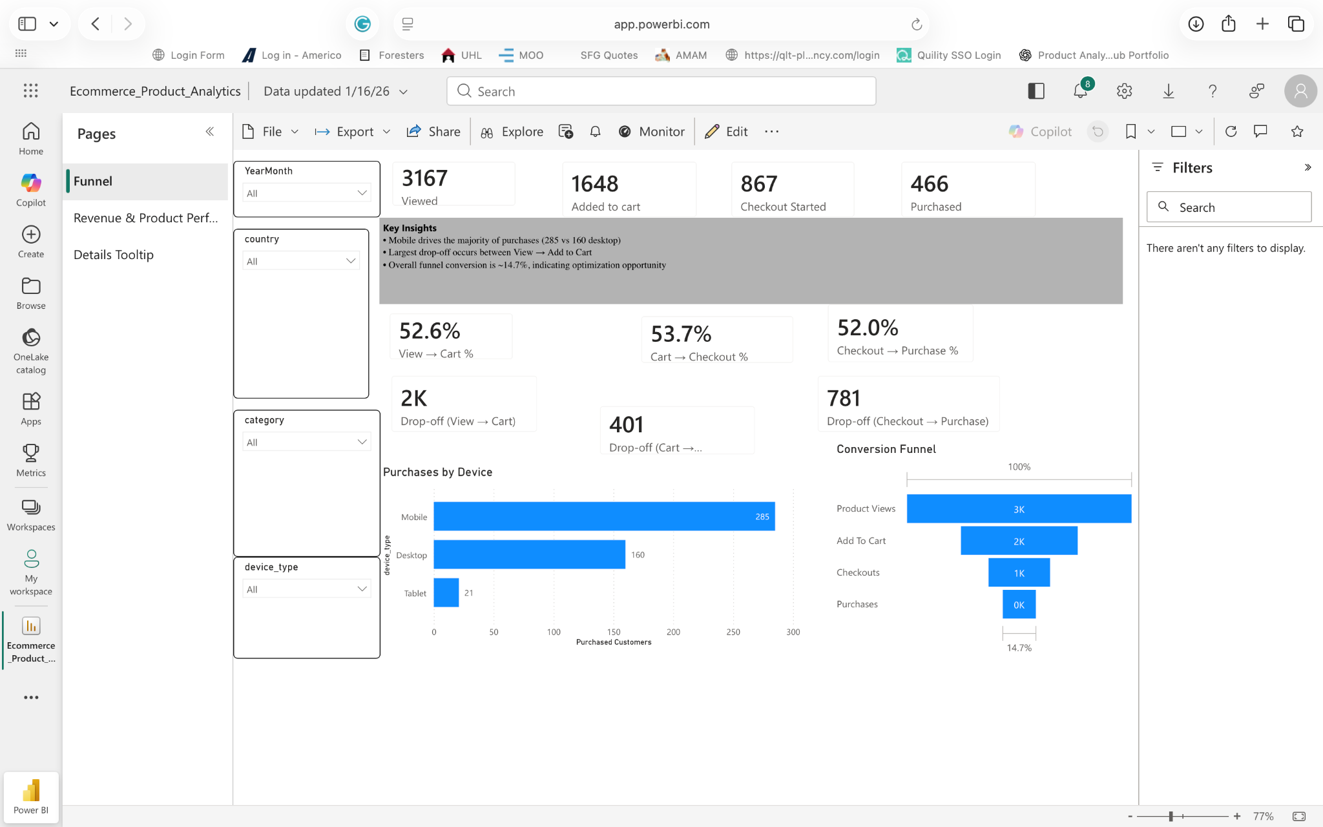
Dashboard Insight: Ecommerce Conversion Funnel
Jamie Christian | Product Owner Portfolio

Slide 8
How I Operate as a Product Owner
Strategy Alignment
• Translate business goals into measurable outcomes • Define North Star metric & KPI framework • Align roadmap to quarterly objectives
Backlog Ownership
• Prioritize using RICE / MoSCoW frameworks • Write structured user stories with acceptance criteria • Decompose initiatives into sprint-ready tasks
Sprint Execution
• Lead planning & backlog refinement sessions • Clarify scope before development begins • Protect sprint focus & manage trade-offs
Data-Driven Decisions
• Monitor funnel & performance KPIs • Identify drop-offs & optimization opportunities • Convert insights into backlog priorities
Continuous Optimization
• Run A/B experiments & performance tests • Iterate based on real usage data • Scale successful features, sunset low-impact work
Jamie Christian | Product Owner Portfolio

